Slide 1
Introduction to Edge Detection
Presented by Sequoia Andrade
Summary of original presentation by Shree K. Nayar

Slide 2
Outline
Motivation
Edges
Characteristics of Edge Detectors
Edge Detection Methods
Method set up
Gradients
Laplacian
Canny
Corner Detection
Edge Detector Comparison
Challenges
Summary

Slide 3
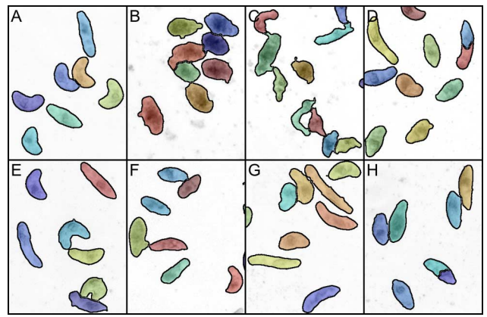
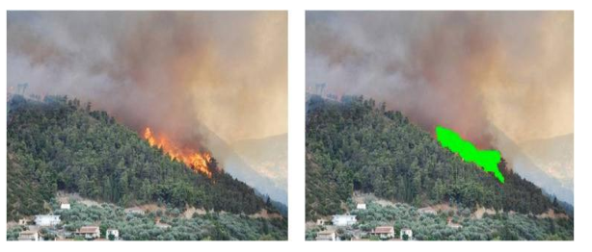
Motivation – Why Edge Detection?
Edge detection is a key capability of computer vision systems
Example use cases include:
Medicine: Individual parasite recognition
Wildfire monitoring: separating smoke from clouds and fire in aerial or satellite images
General: decreases complexity of an image for processing
Need fast, highly accurate algorithms
[2]
[1]

Slide 4
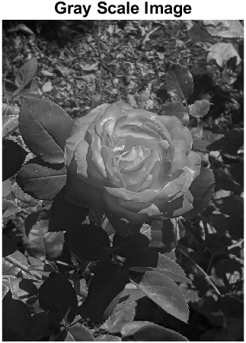
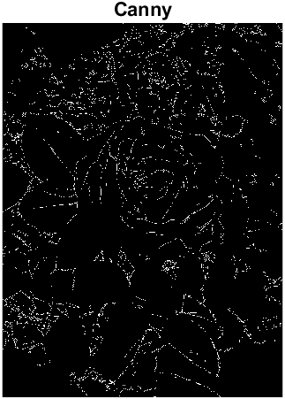
Edges
Edges are easy for humans to visually define in the real world – they define contours of an object, and where an object ends or meets another object
For a computer, an edge can formally defined as a place in an image with “rapid intensity change”
Intensity is caused by physical phenomena

Slide 5
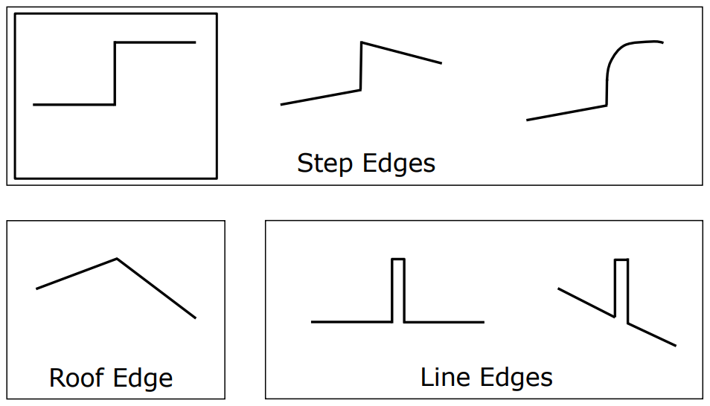
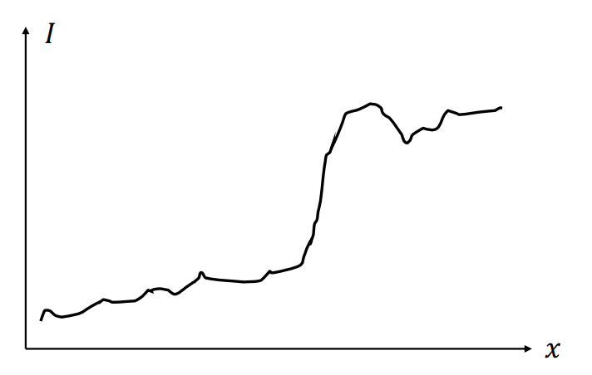
Edges
There are specific types of edges that exist, however in real images there is noise
What do these ideal edge types mean in a real image?
A step-edge is a discontinuity in shading, e.g., a change in color
A roof edge is a subtle shading gradient that forms and edge, e.g., a slight shadow or highlight on an object
A line edge is defined by a boarder between two objects

Slide 6
Edge Detectors
Edge detectors should identify:
Edge position
Edge magnitude (strength)
Edge orientation (direction)
Considerations:
Computational performance
Accuracy (i.e., detection rate)
Sensitivity to noise
Localization (i.e., proximity to true edge)

Slide 7
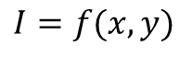
Edge Detection problem set up
Consider images as functions
1-D vs 2-D (sound vs image)
Continuous vs discrete – most images are seen as discrete function of pixels
y
$$I=f(x,y)$$
x

Slide 8
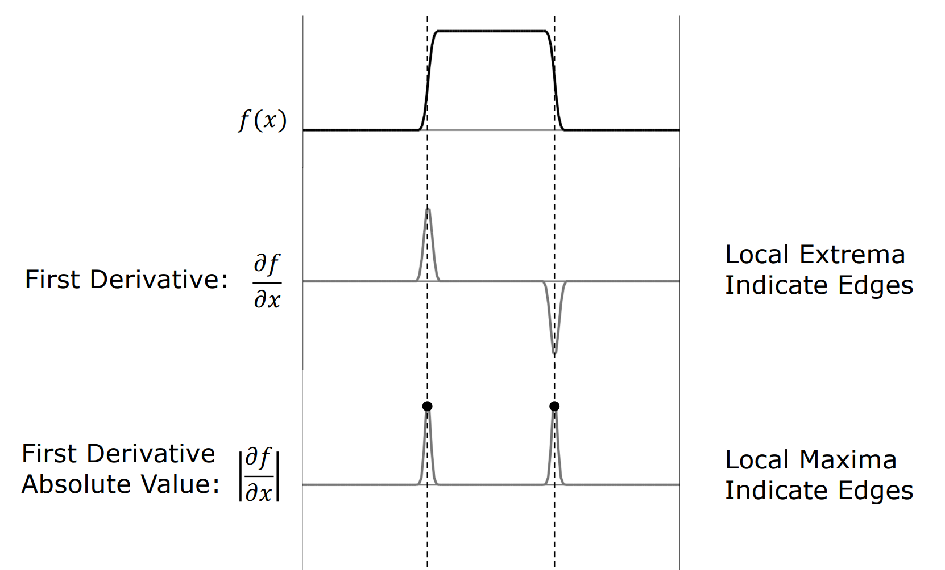
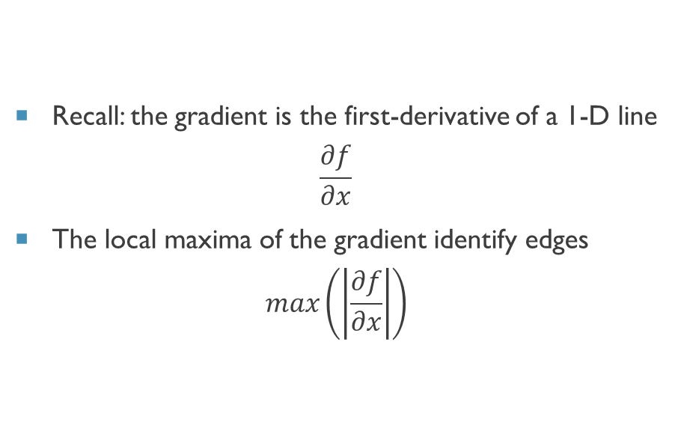
Gradients for edge detection – 1D
Recall: the gradient is the first-derivative of a 1-D line
$$\frac{∂f}{∂x}$$
The local maxima of the gradient identify edges
$$max\left(\left|\frac{∂f}{∂x}\right|\right)$$

Slide 9
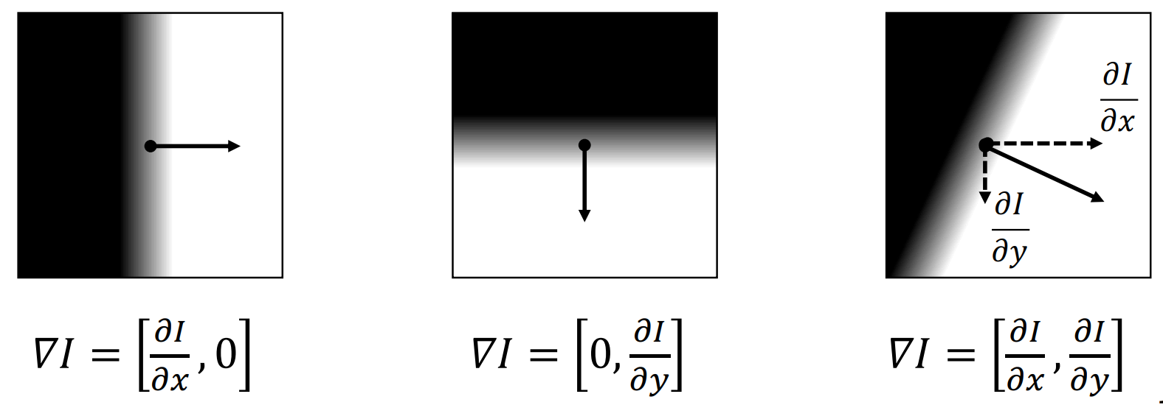
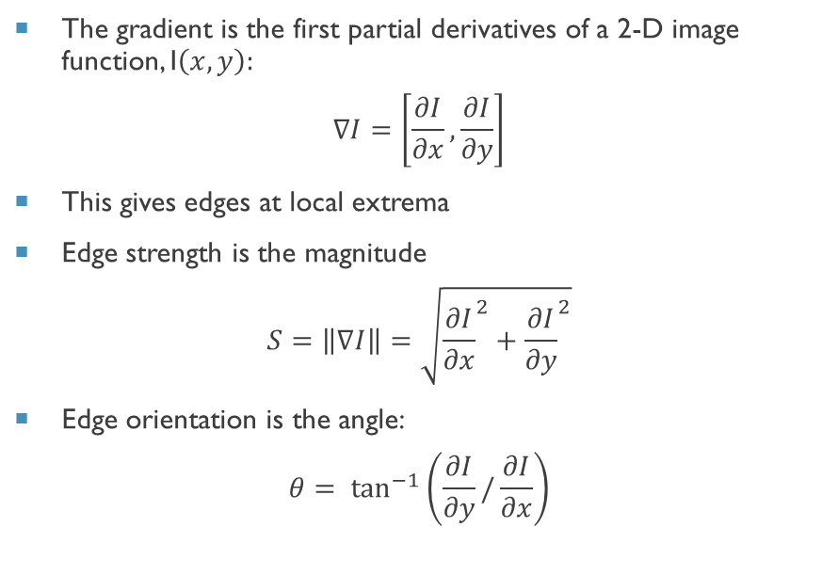
Gradients for edge detection – 2D
The gradient is the first partial derivatives of a 2-D image function, I$\left(x,y\right):$
$$∇I=\left[\frac{∂I}{∂x},\frac{∂I}{∂y}\right]$$
This gives edges at local extrema
Edge strength is the magnitude
$$S=\left\|∇I\right\|=\sqrt{{\frac{∂I}{∂x}}^{2}+{\frac{∂I}{∂y}}^{2}}$$
Edge orientation is the angle:
$$θ= \tan^{−1}\left(\frac{∂I}{∂y}/\frac{∂I}{∂x}\right)$$

Slide 10
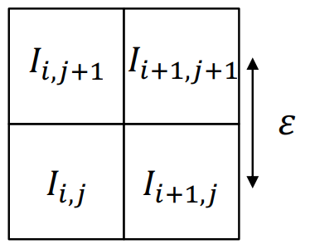
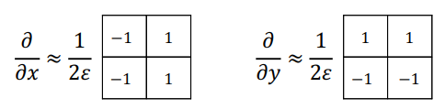
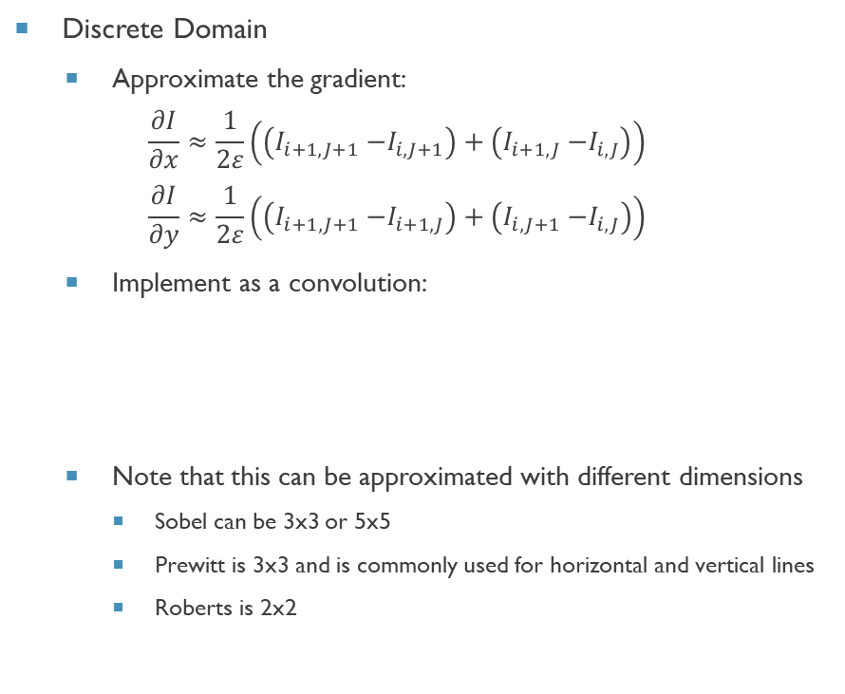
Gradients for edge detection – Variants
Discrete Domain
Approximate the gradient:
$$\frac{∂I}{∂x}≈\frac{1}{2ε}\left(\left(I_{i+1, J+1}{−I}_{i, J+1}\right)+\left(I_{i+1, J}{−I}_{i, J}\right)\right)$$
$$\frac{∂I}{∂y}≈\frac{1}{2ε}\left(\left(I_{i+1, J+1}{−I}_{i+1, J}\right)+\left(I_{i, J+1}{−I}_{i, J}\right)\right)$$
Implement as a convolution:
Note that this can be approximated with different dimensions
Sobel can be 3x3 or 5x5
Prewitt is 3x3 and is commonly used for horizontal and vertical lines
Roberts is 2x2

Slide 11
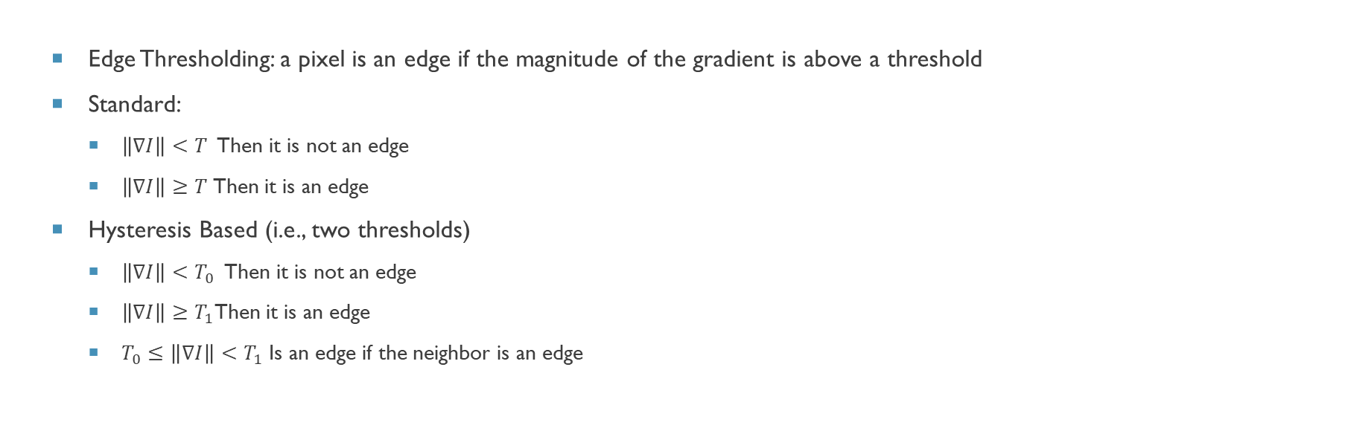
Gradients for edge detection – Variants
Edge Thresholding: a pixel is an edge if the magnitude of the gradient is above a threshold
Standard:
$\left\|∇I\right\|<T$ Then it is not an edge
$\left\|∇I\right\|≥T$Then it is an edge
Hysteresis Based (i.e., two thresholds)
$\left\|∇I\right\|<T_{0}$ Then it is not an edge
$\left\|∇I\right\|≥T_{1}$Then it is an edge
$T_{0}≤\left\|∇I\right\|<T_{1}$Is an edge if the neighbor is an edge

Slide 12
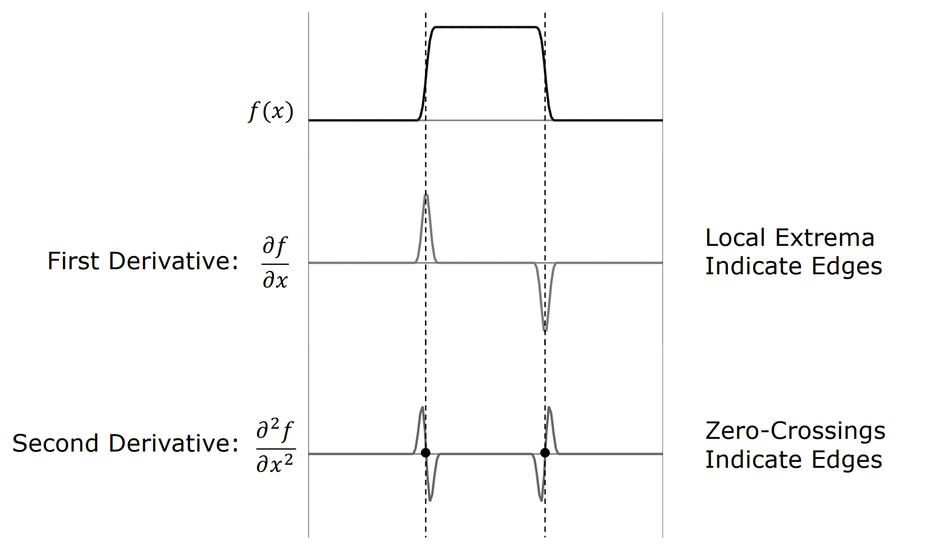
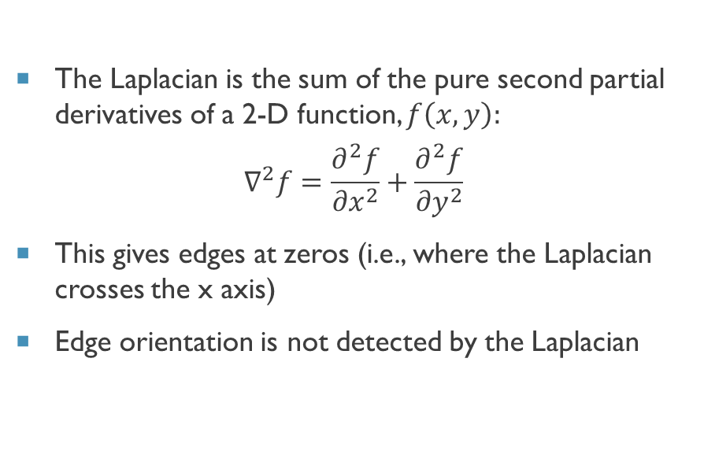
Laplacian for edge detection
The Laplacian is the sum of the pure second partial derivatives of a 2-D function, $f\left(x,y\right):$
$$∇^{2}f=\frac{∂^{2}f}{{∂x}^{2}}+\frac{∂^{2}f}{{∂y}^{2}}$$
This gives edges at zeros (i.e., where the Laplacian crosses the x axis)
Edge orientation is not detected by the Laplacian

Slide 13
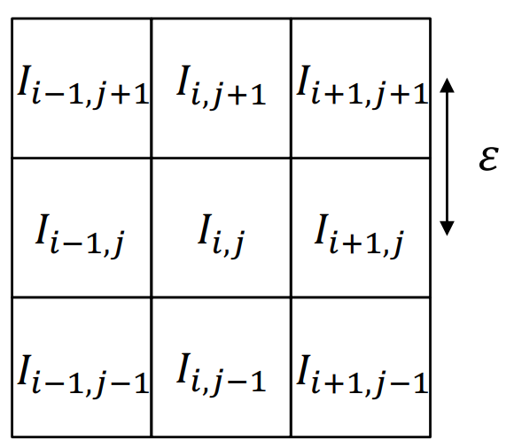
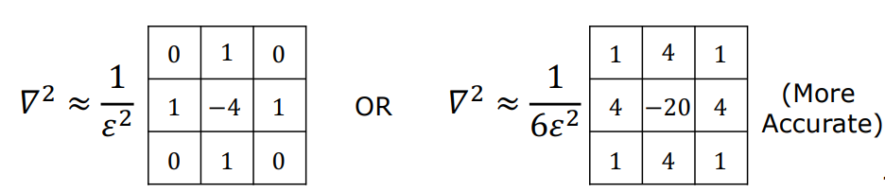
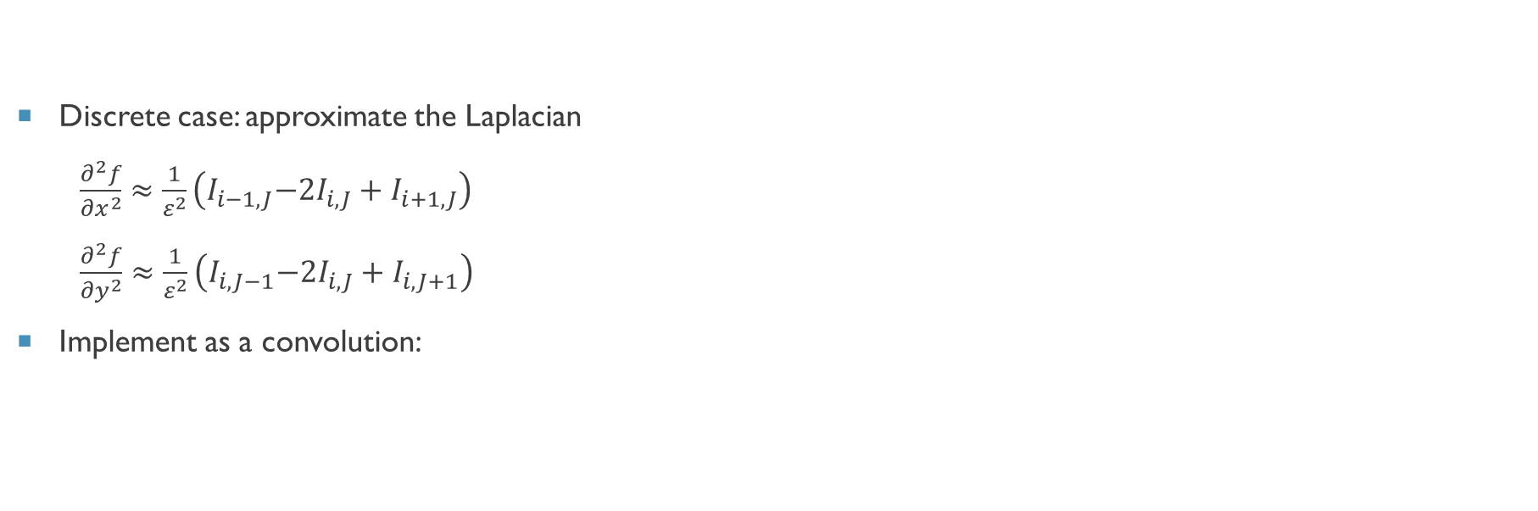
Laplacian for edge detection – variants
Discrete case: approximate the Laplacian
$\frac{∂^{2}f}{{∂x}^{2}}$ $≈\frac{1}{ε^{2}}\left(I_{i−1, J}{{−2I}_{i, J}+I}_{i+1, J}\right)$
$\frac{∂^{2}f}{{∂y}^{2}}$ $≈\frac{1}{ε^{2}}\left(I_{i, J−1}{{−2I}_{i, J}+I}_{i, J+1}\right)$
Implement as a convolution:

Slide 14
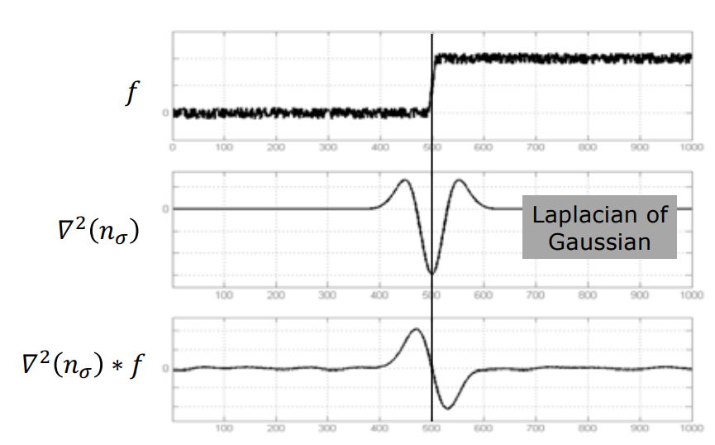
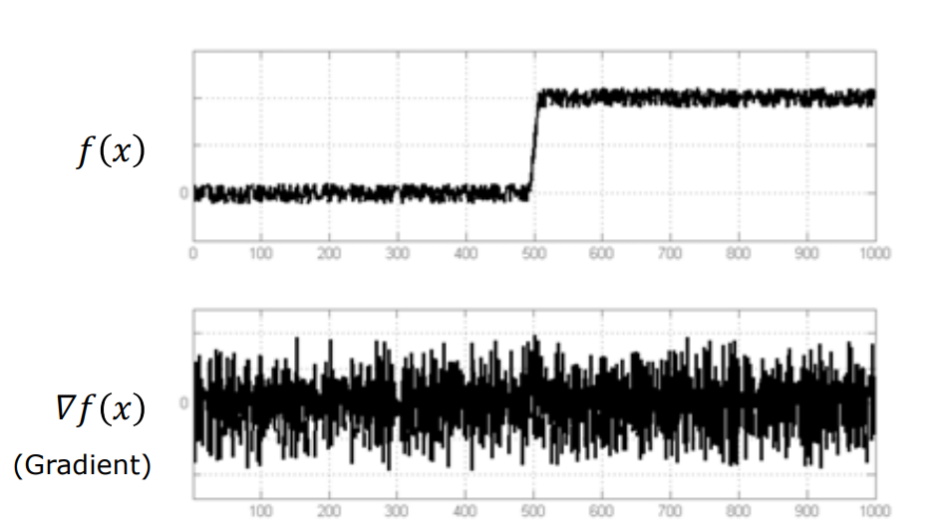
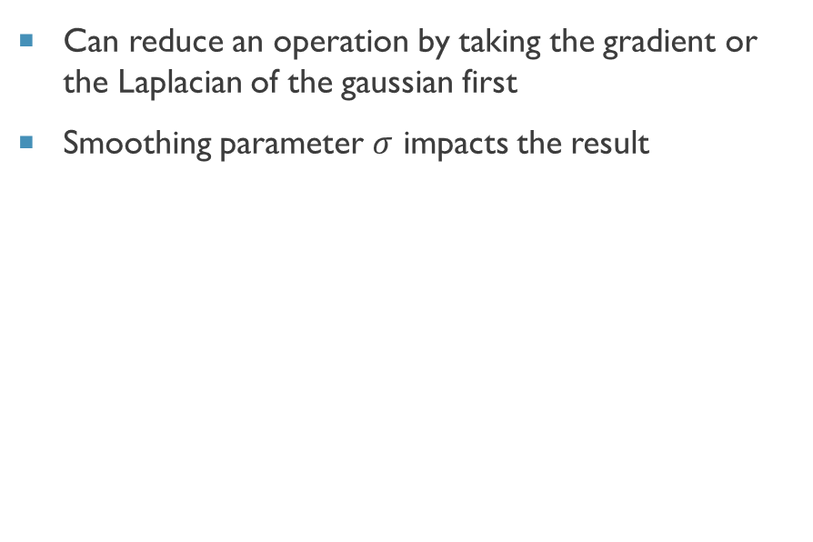
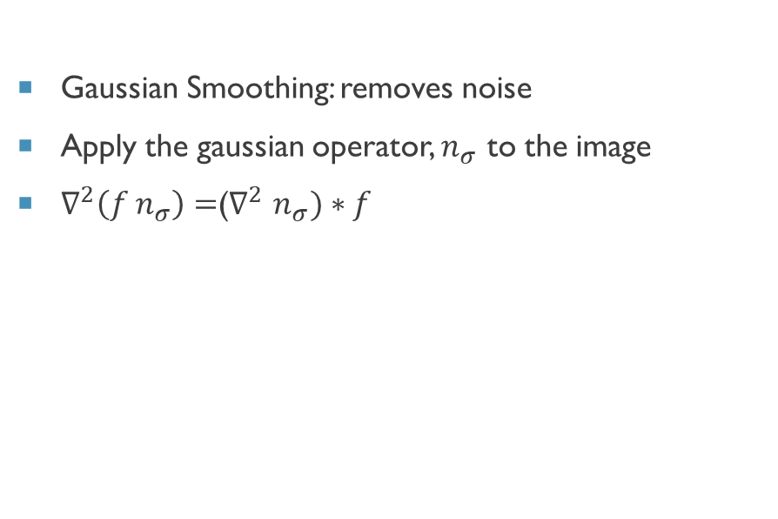
Laplacian for edge detection – variants
Gaussian Smoothing: removes noise
Apply the gaussian operator, $n_{σ}$ to the image
$∇^{2}\left(f n_{σ}\right)=$($∇^{2}$ $n_{σ})∗f$
Can reduce an operation by taking the gradient or the Laplacian of the gaussian first
Smoothing parameter $σ$ impacts the result

Slide 15
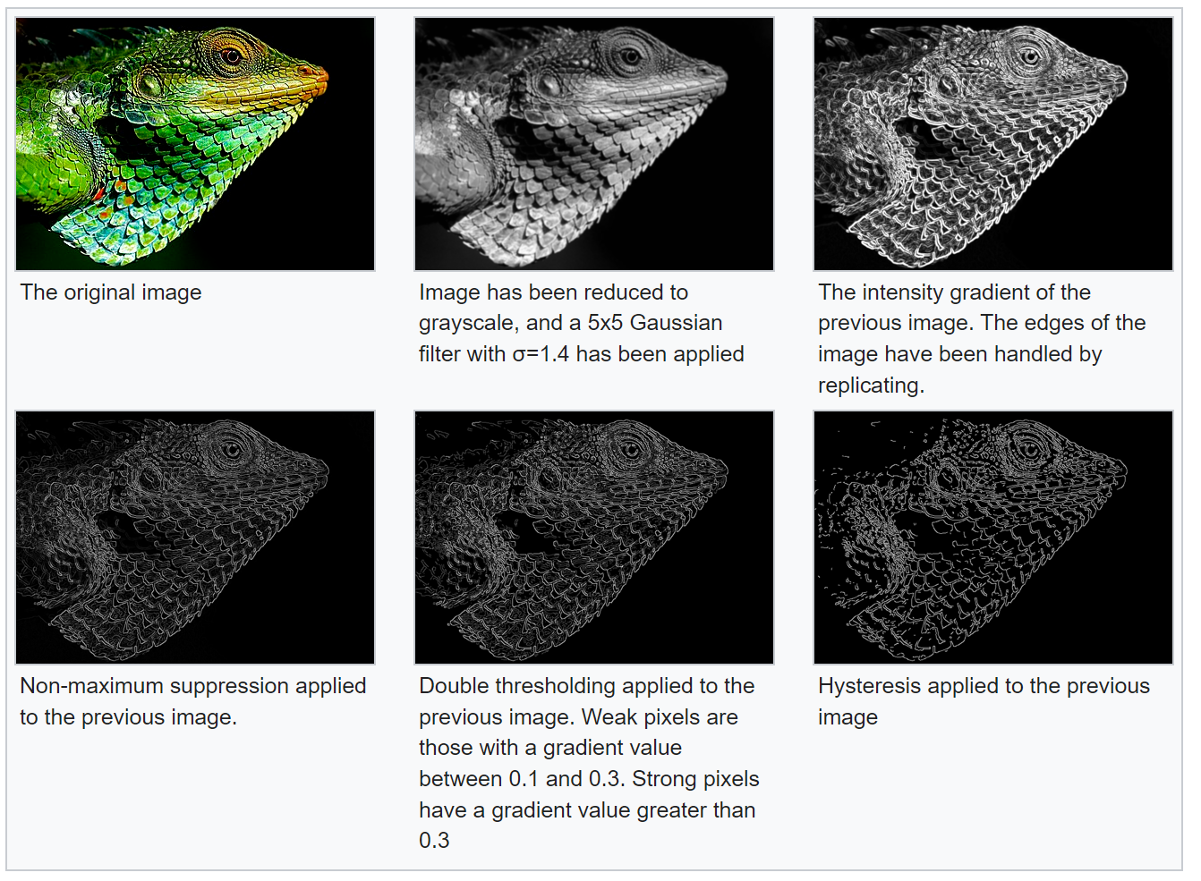
Canny Edge Detector
Smooth image with 2-D gaussian
Compute image gradient with Sobel filter
Find gradient magnitude at each pixel
Find gradient orientation at each pixel
Compute Laplacian along the Gradient direction at each pixel
Find zero crossings of Laplacian for edge locations
Additional steps, including thresholding and edge thinning are applied as well
[4]

Slide 16
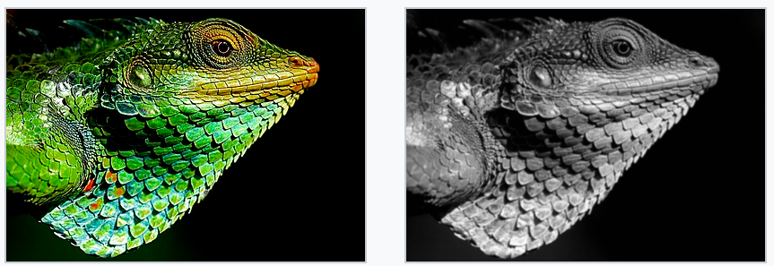
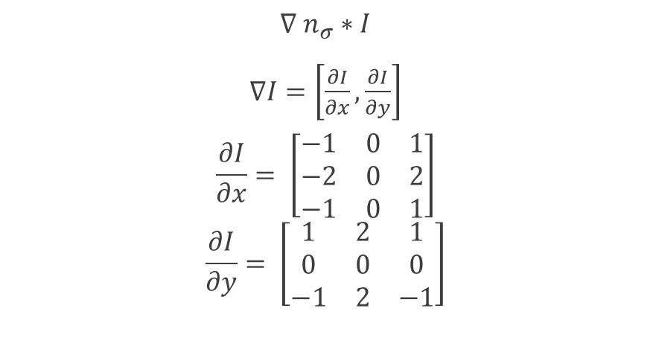
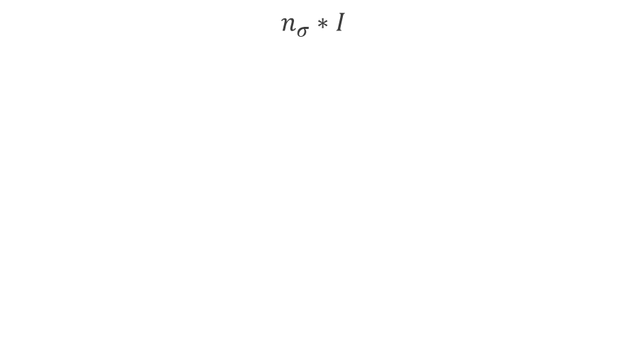
Canny Edge Detector
1. Smooth the image with 2-D Gaussian
2. Compute image gradient with Sobel filter
$$n_{σ}∗I$$
$$∇ n_{σ}∗I$$
$∇I=\left[\frac{∂I}{∂x},\frac{∂I}{∂y}\right]$
$$\frac{∂I}{∂x}= \left[\begin{matrix}−1 & 0 & 1 \\ −2 & 0 & 2 \\ −1 & 0 & 1\end{matrix}\right]$$
$$\frac{∂I}{∂y}= \left[\begin{matrix}1 & 2 & 1 \\ 0 & 0 & 0 \\ −1 & 2 & −1\end{matrix}\right]$$
[4]

Slide 17
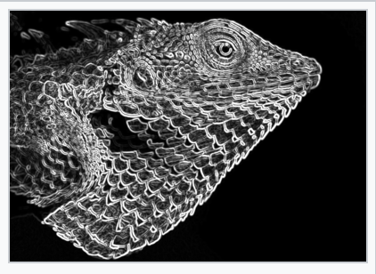
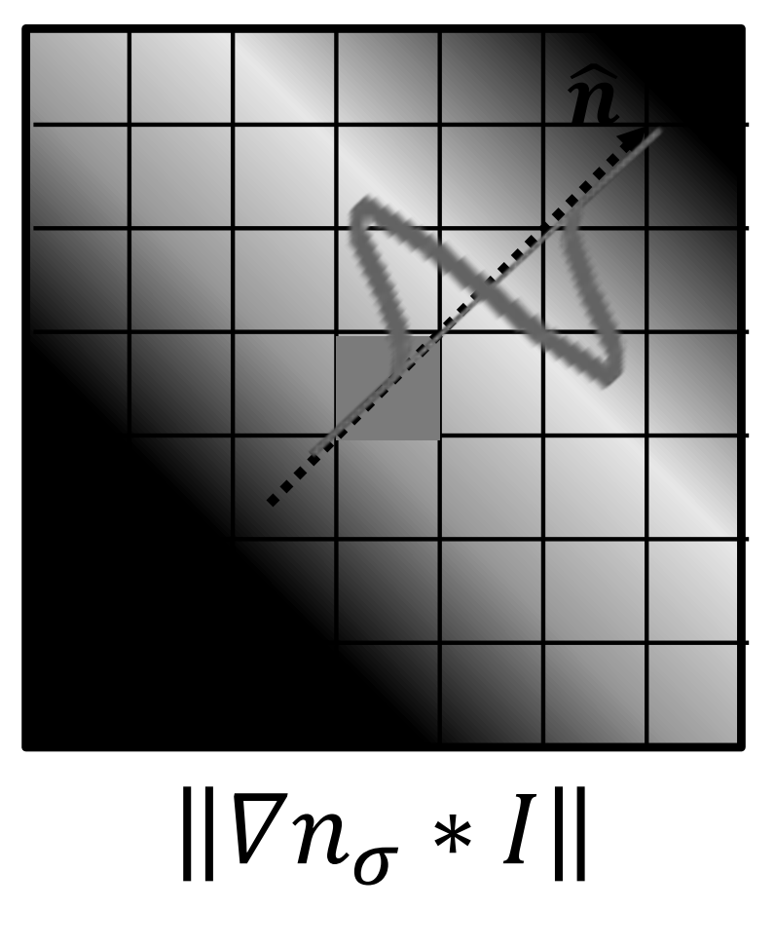
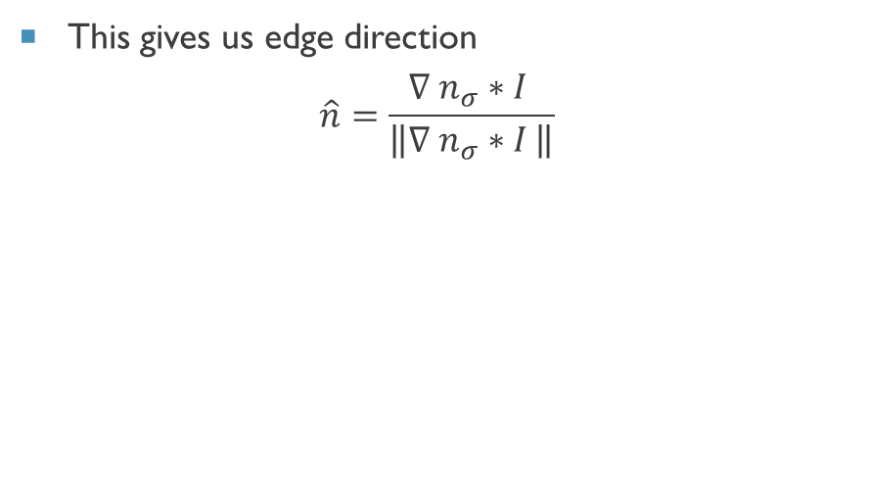
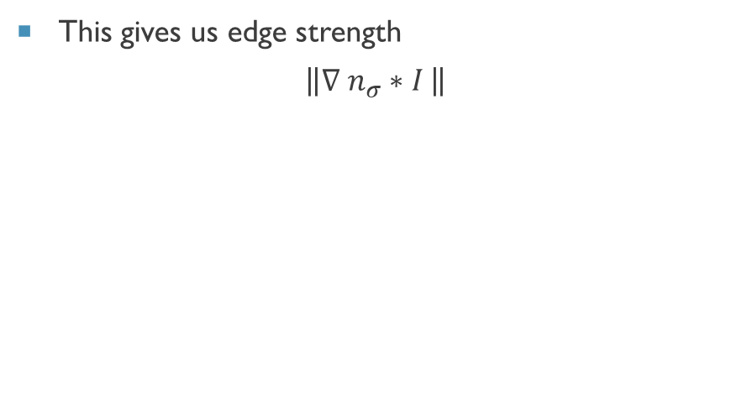
Canny Edge Detector
3. Find Gradient Magnitude
4. Find Gradient Orientation
This gives us edge strength
$$\left\|∇ n_{σ}∗I \right\|$$
This gives us edge direction
$$\hat{n}=\frac{∇ n_{σ}∗I }{\left\|∇ n_{σ}∗I \right\|}$$
[4]

Slide 18
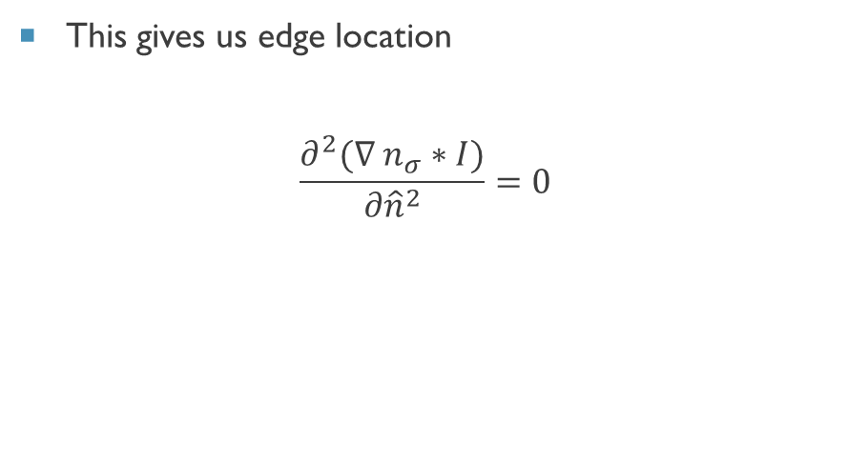
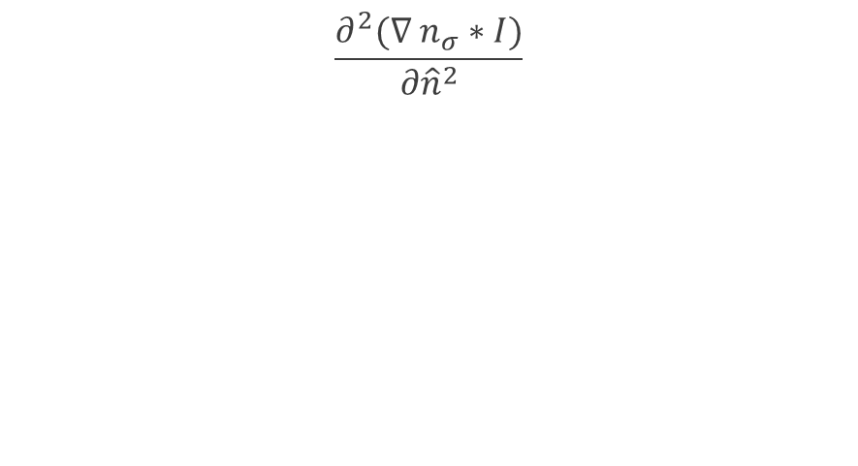
Canny Edge Detector
5. Compute Laplacian (1-D) along the direction of the gradient
6. Find zero crossings of Laplacian for edge Locations
$$\frac{∂^{2}(∇ n_{σ}∗I)}{{∂\hat{n}}^{2}}$$
This gives us edge location
$$\frac{∂^{2}(∇ n_{σ}∗I)}{{∂\hat{n}}^{2}}=0$$

Slide 19
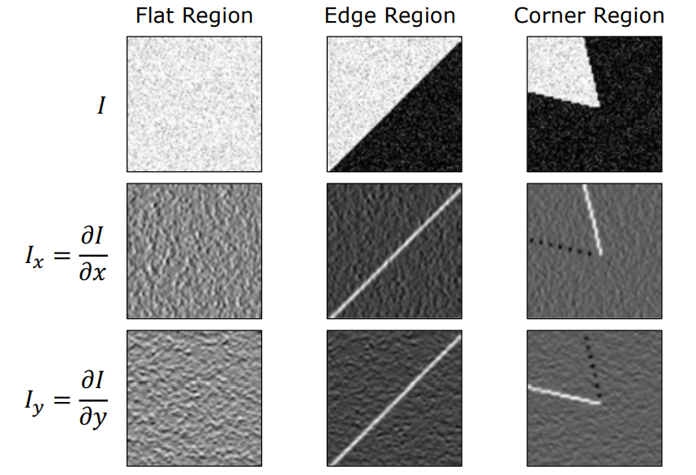
Corner Detection
Corners are locations where two edges meet
There is a variety of methods for corner detection:
…but this is out of scope for this presentation

Slide 20
Comparison
Consideration | Gradient | Laplacian | Canny
Computational Performance | Medium Complexity | Medium Complexity | More Complex
Accuracy | Low | Medium | Good
Sensitivity to noise | Low | Medium | Medium
Localization | Poor | Medium | Good
Edge Location | Yes | Yes | Yes
Edge Strength | Yes | No | Yes
Edge Orientation | Yes | No | Yes

Slide 21
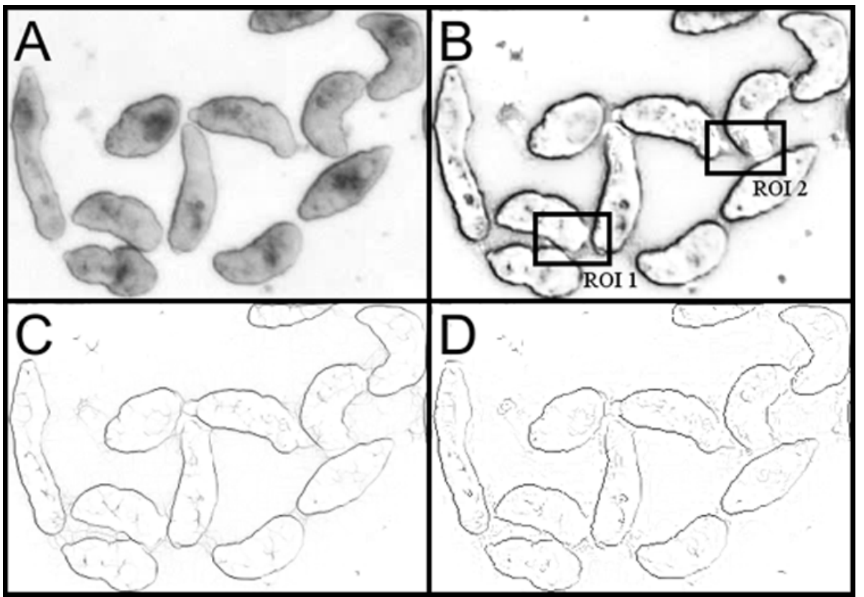
Challenges
Noise – how to find the right balance
Touching Objects
[2]

Slide 22
Summary
Different methods for edge detection:
Gradient, Laplacian, Canny, and others
Each method has benefits and draw backs
Canny edge detector is considered a state-of-the-art detector
While these algorithms can be considered mathematically complex, they can be implemented in few lines of code using existing libraries in matlab or python

Slide 23
References
[1] Vipin, V. (2012). Image Processing Based Forest Fire Detection.
[2] Asarnow, D.E., & Singh, R. (2013). Segmenting the Etiological Agent of Schistosomiasis for High-Content Screening. IEEE Transactions on Medical Imaging, 32, 1007-1018.
[3] Shree K. Nayar (2022) Edge Detection. Columbia University.
[4] Wikipedia contributors. (2022, October 4). Canny edge detector. In Wikipedia, The Free Encyclopedia.

